Slide 1
Chapter 19 Aldehydes and Ketones: Nucleophilic Addition Reactions

Slide 2
Learning Objectives
(19.1)
Naming aldehydes and ketones
(19.2)
Preparing aldehydes and ketones
(19.3)
Oxidation of aldehydes and ketones
(19.4)
Nucleophilic addition reactions of aldehydes and ketones

Slide 3
Learning Objectives
(19.5)
Nucleophilic addition of H₂O: Hydration
(19.6)
Nucleophilic addition of HCN: Cyanohydrin formation
(19.7)
Nucleophilic addition of hydride and Grignard reagents: Alcohol formation

Slide 4
Learning Objectives
(19.8)
Nucleophilic addition of amines: Imine and enamine formation
(19.9)
Nucleophilic addition of hydrazine: The Wolff- Kishner reaction
(19.10)
Nucleophilic addition of alcohols: Acetal formation

Slide 5
Learning Objectives
(19.11)
Nucleophilic addition of phosphorus ylides: The Wittig Reaction
(19.12)
Biological reductions
(19.13)
Conjugate nucleophilic addition to α, β-unsaturated aldehydes and ketones
(19.14)
Spectroscopy of aldehydes and ketones

Slide 6
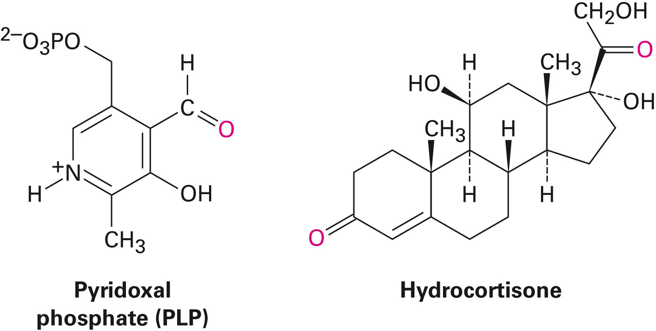
Aldehydes and Ketones
Aldehydes (RCHO) and ketones (R₂CO) are characterized by the carbonyl functional group (C=O)
The compounds occur widely in nature as intermediates in metabolism and biosynthesis
Notes:
Naming aldehydes and ketones

Slide 7
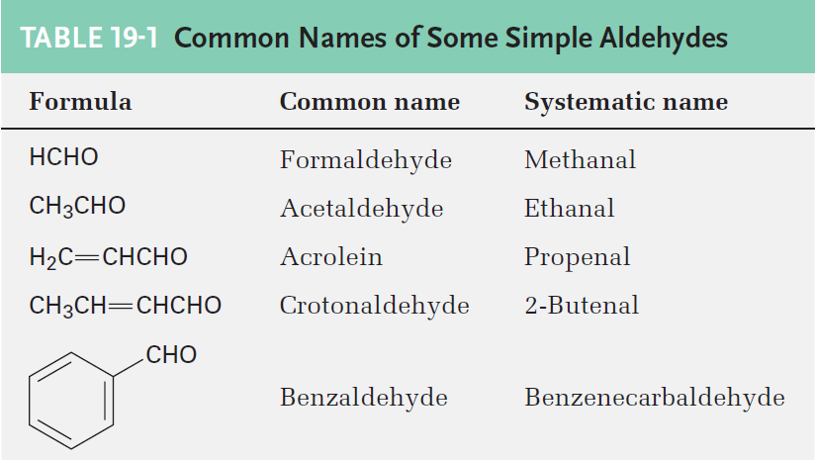
Naming Aldehydes and Ketones
Aldehydes are named by replacing the terminal –e of the corresponding alkane name with –al
Parent chain must contain the –CHO group
–CHO carbon is numbered as C1
If the –CHO group is attached to a ring, use the suffix carbaldehyde
Notes:
Naming aldehydes and ketones

Slide 8
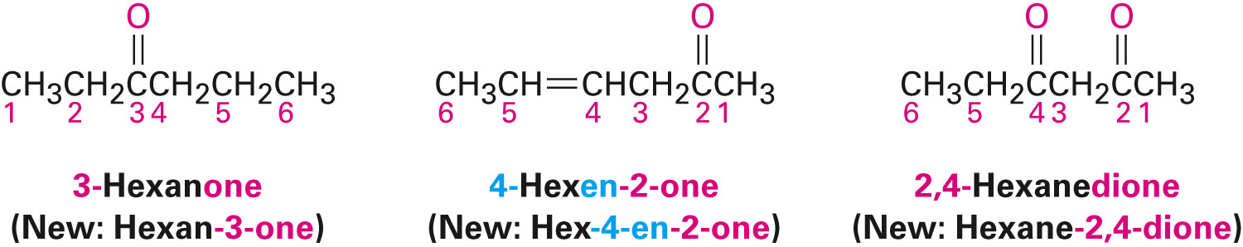
Naming Aldehydes and Ketones
The terminal –e of the alkane name is replaced with –one
Parent chain is the longest one that contains the ketone group
Numbering begins at the end nearer to the carbonyl carbon
Notes:
Naming aldehydes and ketones

Slide 9
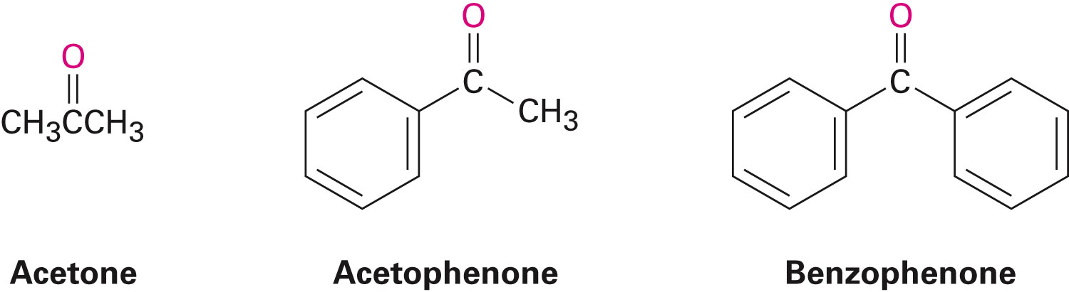
Naming Aldehydes and Ketones
IUPAC retains names for a few ketones
Notes:
Naming aldehydes and ketones

Slide 10
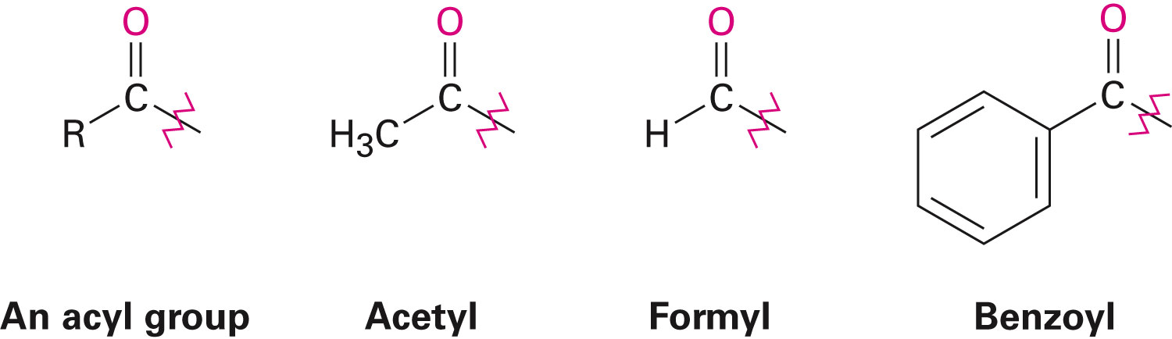
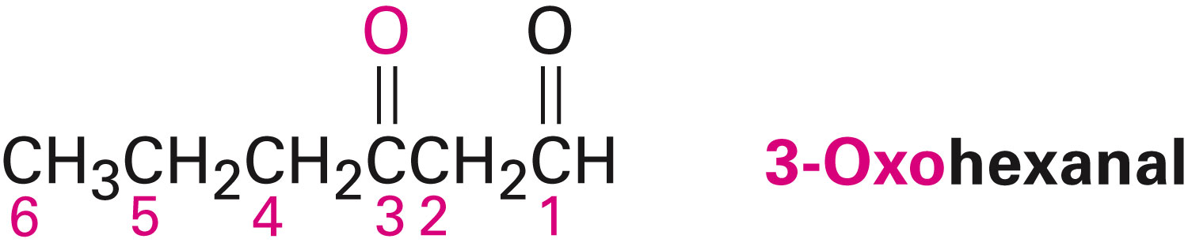
Naming Aldehydes and Ketones
The R–C=O as a substituent is an acyl group, used with the suffix -yl from the root of the carboxylic acid
The prefix oxo- is used if other functional groups are present and the doubly bonded oxygen is labeled as a substituent on a parent chain
Notes:
Naming aldehydes and ketones

Slide 11
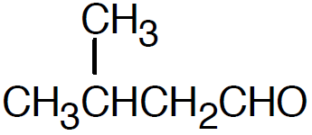
Worked Example
Draw structures corresponding to the following names
a) 3-Methylbutanal
b) Cis-3-tert-Butylcyclohexanecarbaldehyde
Solution:
a) 3-Methylbutanal
Notes:
Naming aldehydes and ketones

Slide 12
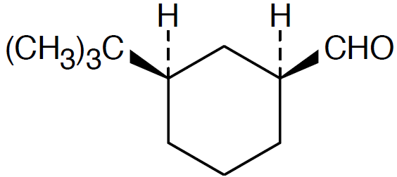
Worked Example
b) cis-3-tert-Butylcyclohexanecarbaldehyde
Notes:
Naming aldehydes and ketones

Slide 13
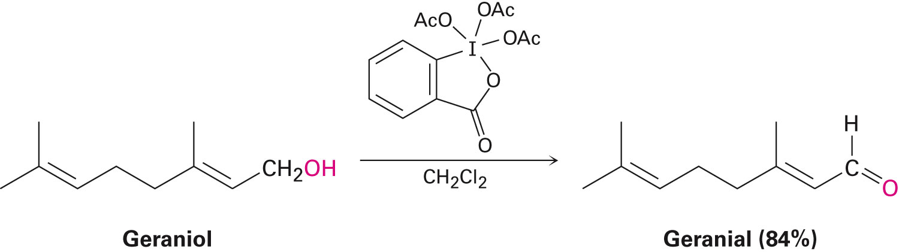
Preparing Aldehydes
Oxidization of primary alcohols using Dess-Martin pyridinium reagent in dichloromethane solvent
Certain carboxylic acid derivatives can be partially reduced to yield aldehydes
Notes:
Preparing aldehydes and ketones

Slide 14
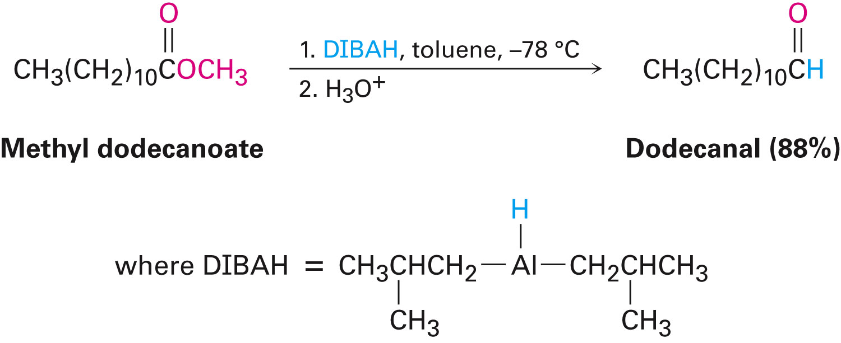
Preparing Aldehydes
Example
Partial reduction of an ester by diisobutylaluminum hydride
Notes:
Preparing aldehydes and ketones

Slide 15
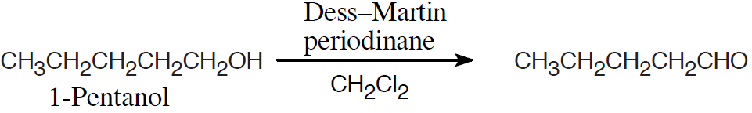
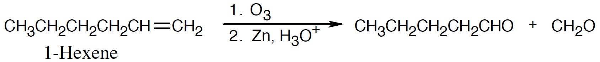
Worked Example
How is pentanal prepared from the following starting materials
a) CH₃CH₂CH₂CH₂CH₂OH
b) CH₃CH₂CH₂CH₂CH=CH₂
Solution:
a)
b)
Notes:
Preparing aldehydes and ketones

Slide 16
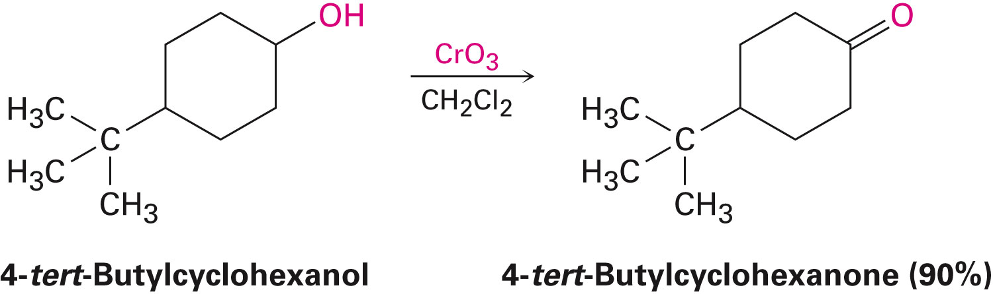
Preparing Ketones
Oxidization of a secondary alcohol
Choice of oxidant is based on factors such as:
Scale
Cost
Acid/base sensitivity of the alcohol
Dess–Martin periodinane or a Cr(VI) reagent are a common choice
Notes:
Preparing aldehydes and ketones

Slide 17
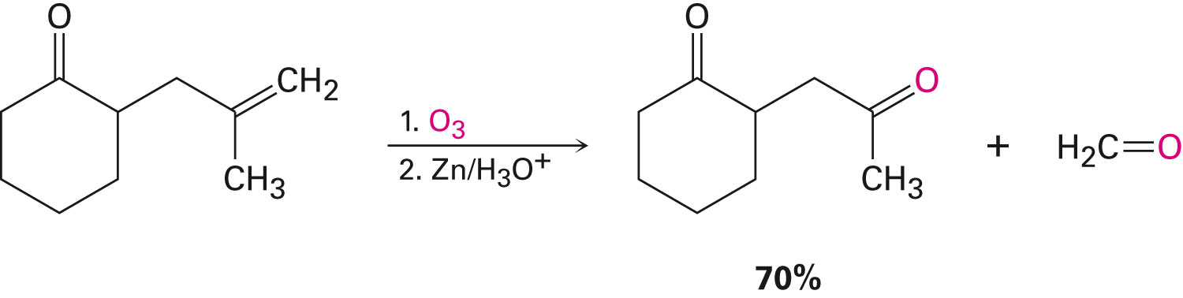
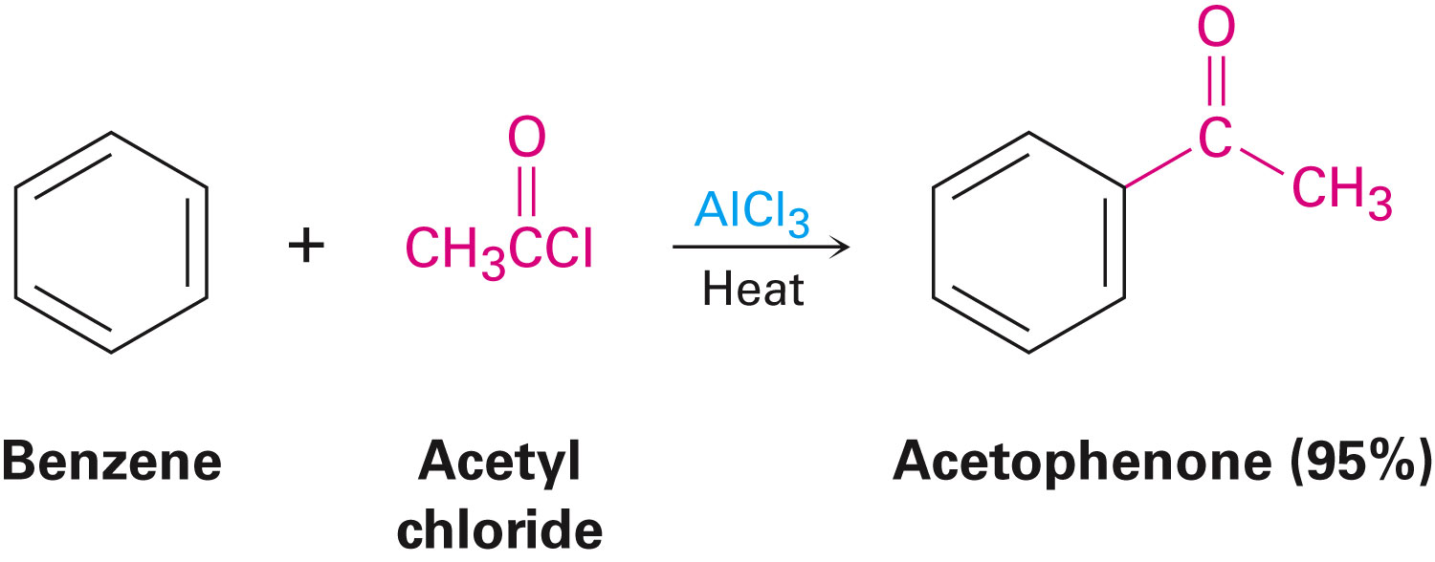
Preparing Ketones
Ozonolysis of alkenes yields ketones if one of the unsaturated carbon atoms is disubstituted
Friedel-Crafts acylation of an aromatic ring with an acid chloride in the presence of AlCl₃ catalyst
Notes:
Preparing aldehydes and ketones

Slide 18
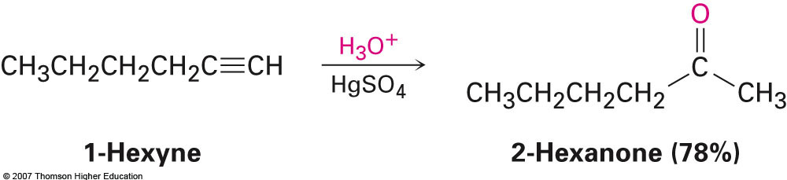
Preparing Ketones
Ketones can also be prepared from certain carboxylic acid derivatives
Notes:
Preparing aldehydes and ketones

Slide 19
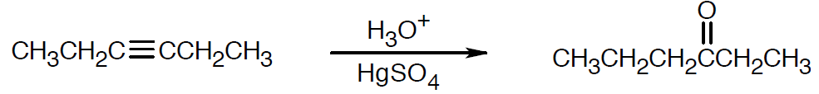
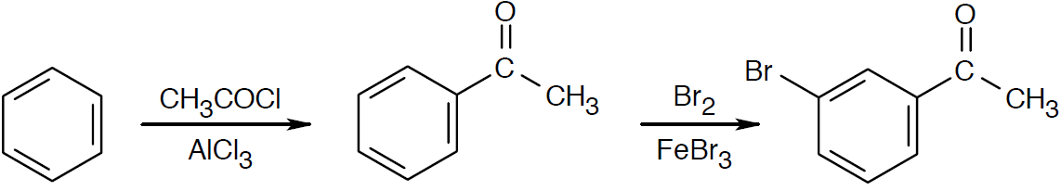
Worked Example
How are the following reactions carried out?
a) 3-Hexyne → 3-Hexanone
b) Benzene → m-Bromoacetophenone
Solution:
a)
b)
Notes:
Preparing aldehydes and ketones

Slide 20
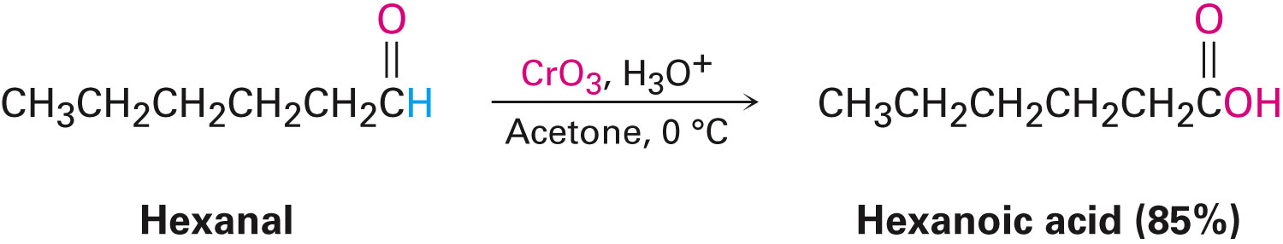
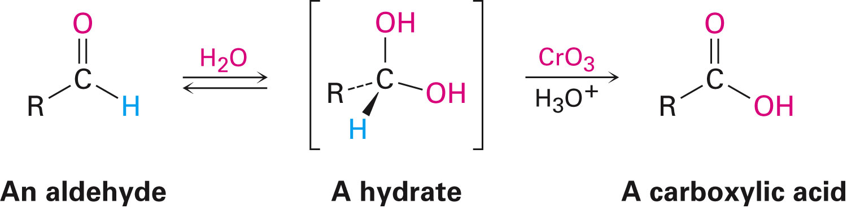
Oxidation of Aldehydes and Ketones
Aldehydes oxidize to yield carboxylic acids
CrO₃ in aqueous acid oxidizes aldehydes to carboxylic acids efficiently
Aldehyde oxidations occur through intermediate 1,1-diols, or hydrates
Notes:
Oxidation of aldehydes and ketones

Slide 21
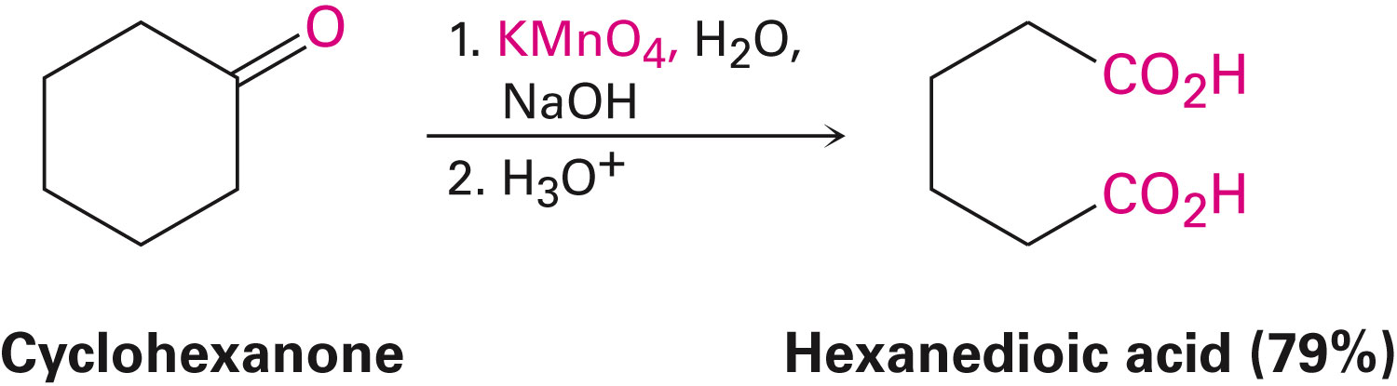
Oxidation of Aldehydes and Ketones
Undergo slow cleavage with hot, alkaline KMnO4
C–C bond next to C=O is broken to give carboxylic acids
Notes:
Oxidation of aldehydes and ketones

Slide 22
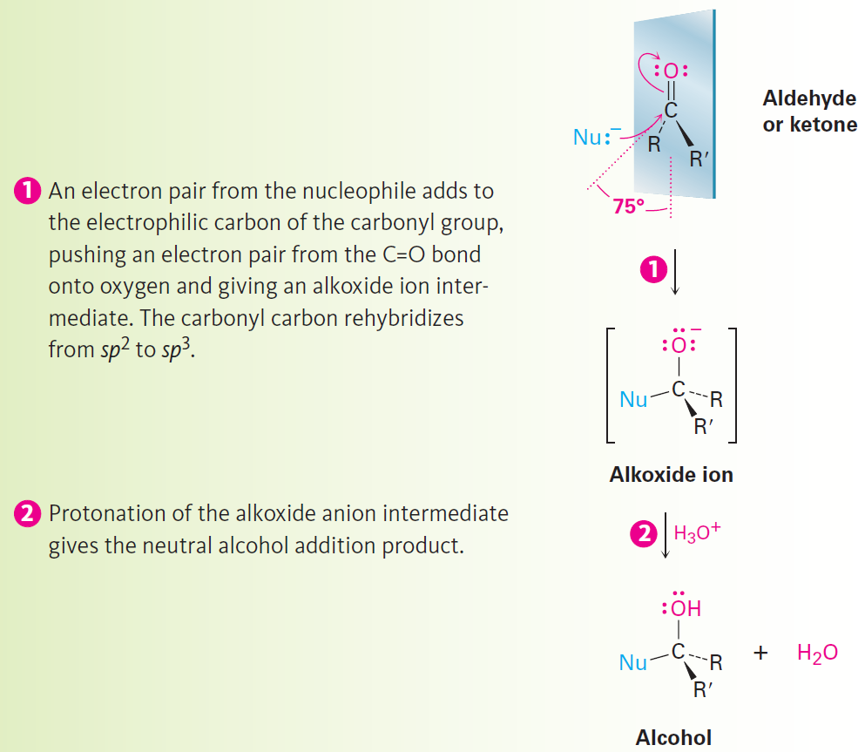
Nucleophilic Addition Reactions of Aldehydes and Ketones
Nu- approaches 75° to the plane of C=O and adds to C
A tetrahedral alkoxide ion intermediate is produced
Notes:
Nucleophilic addition reactions of aldehydes and ketones

Slide 23
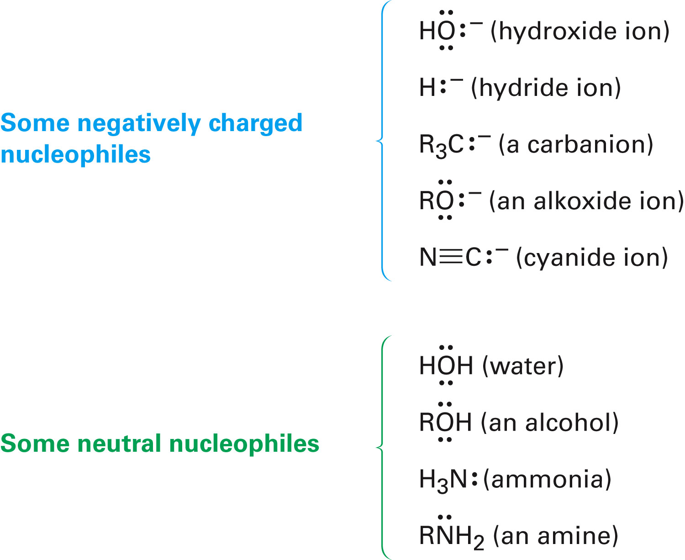
Nucleophilic Addition Reactions of Aldehydes and Ketones
Nucleophiles can be negatively charged (:Nu⁻) or neutral (:Nu) at the reaction site
Notes:
Nucleophilic addition reactions of aldehydes and ketones

Slide 24
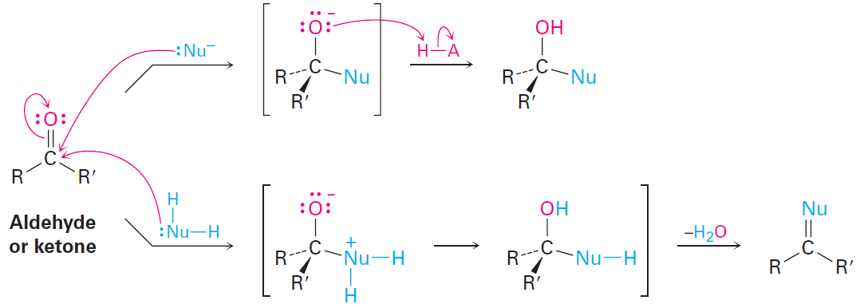
Nucleophilic Addition Reactions of Aldehydes and Ketones
Nucleophilic additions to aldehydes and ketones have two general variations
Product is a direct result of the tetrahedral intermediate being protonated by water or acid
Carbonyl oxygen atom is protonated and eliminated as HO⁻ or H₂O to give a product with a C=Nu double bond
Notes:
Nucleophilic addition reactions of aldehydes and ketones

Slide 25
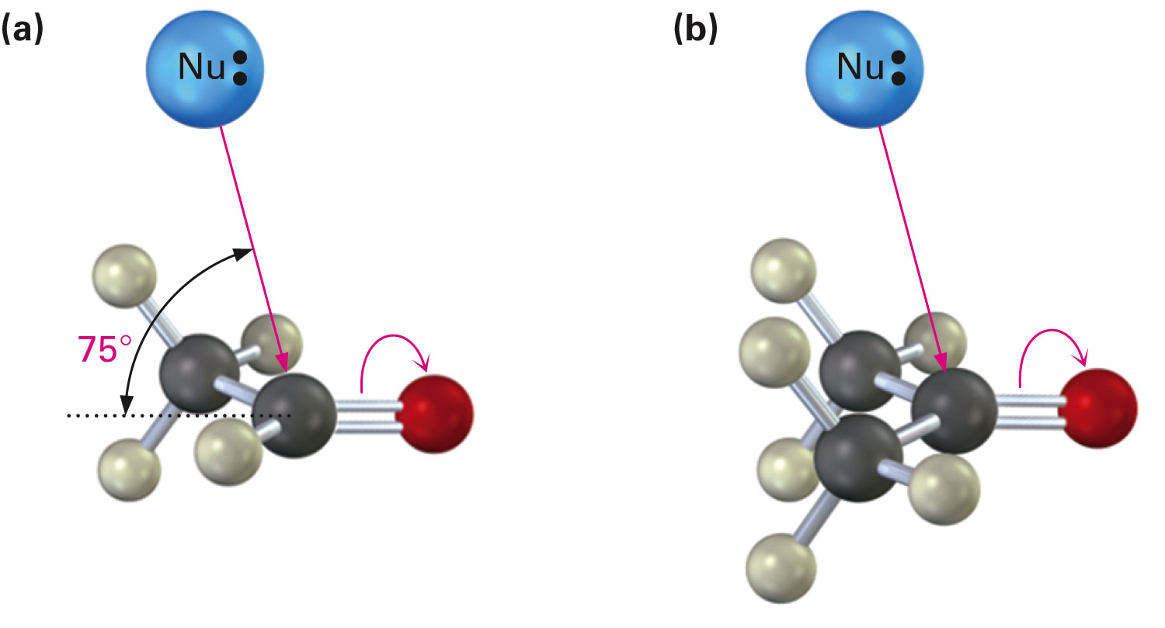
Nucleophilic Addition Reactions of Aldehydes and Ketones
Aldehydes are reactive when compared to ketones in nucleophilic addition reactions
Aldehydes have one large substituent bonded to the C=O, ketones have two
The transition state for addition is less crowded and lower in energy for an aldehyde than for a ketone
Notes:
Nucleophilic addition reactions of aldehydes and ketones

Slide 26
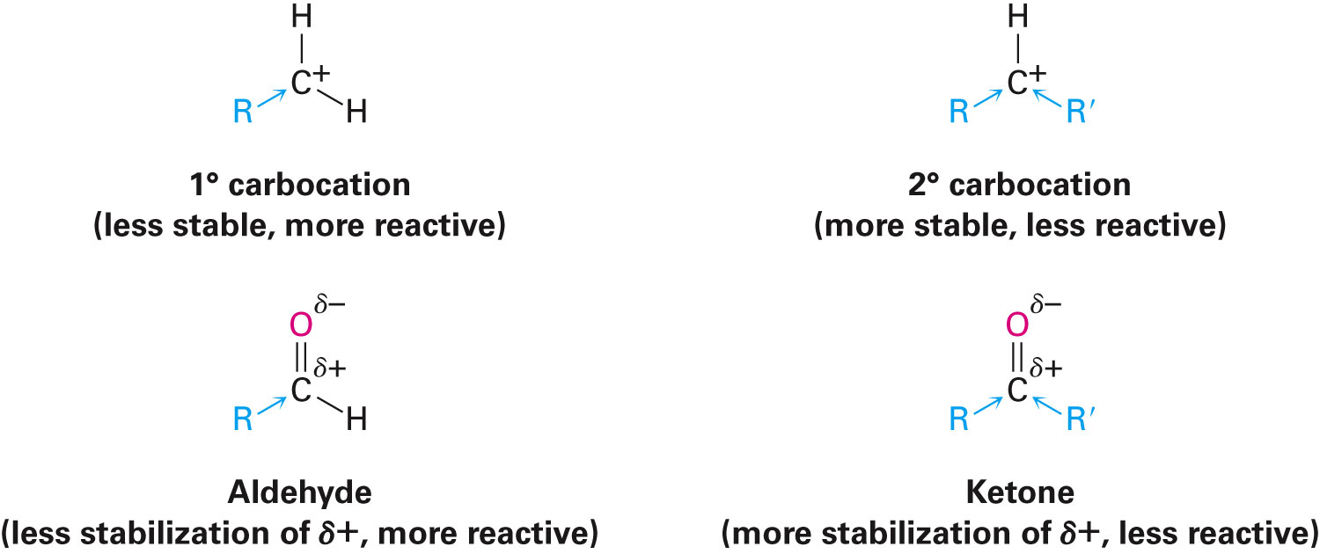
Electrophilicity of Aldehydes and Ketones
Aldehydes are more polarized than ketones
In carbocations, more alkyl groups stabilize the positive charge
Ketone has more alkyl groups, stabilizing the C=O carbon inductively
Notes:
Nucleophilic addition reactions of aldehydes and ketones

Slide 27
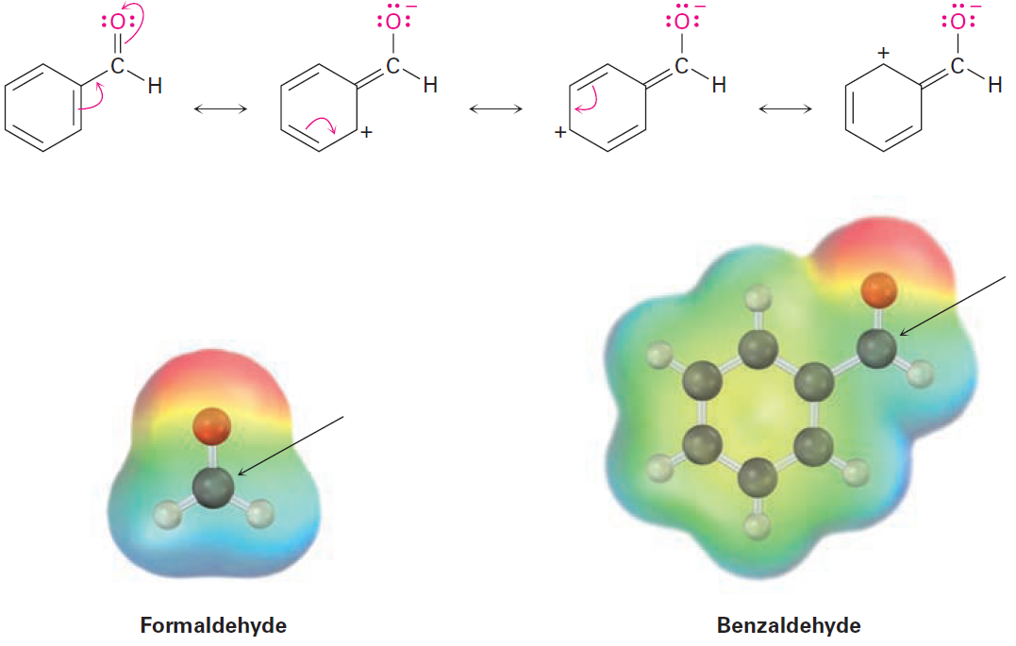
Reactivity of Aromatic Aldehydes
Less reactive in nucleophilic addition reactions than aliphatic aldehydes
Example - Carbonyl carbon atom is less positive in the aromatic aldehyde
Notes:
Nucleophilic addition reactions of aldehydes and ketones

Slide 28
Worked Example
Treatment of an aldehyde or ketone with cyanide ion (–:C≡N), followed by protonation of the tetrahedral alkoxide ion intermediate, gives a cyanohydrin
Show the structure of the cyanohydrin obtained from cyclohexanone
Notes:
Nucleophilic addition reactions of aldehydes and ketones

Slide 29
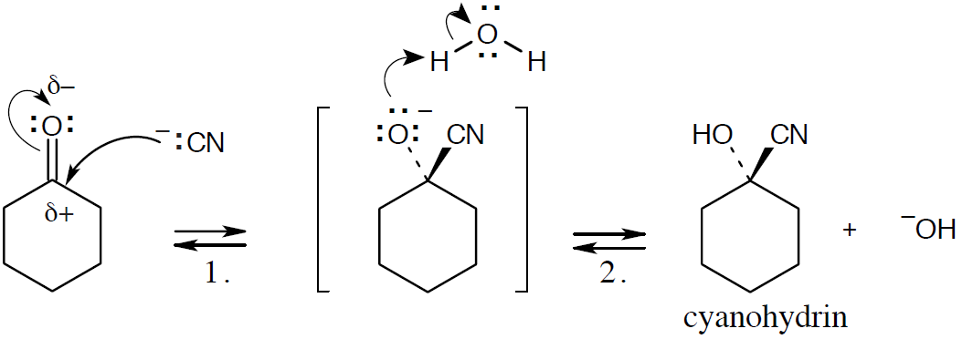
Worked Example
Solution:
Step 1 - Cyanide anion adds to the carbonyl carbon to form a tetrahedral intermediate
Step 2 - Intermediate is protonated to yield the cyanohydrin
Notes:
Nucleophilic addition reactions of aldehydes and ketones

Slide 30
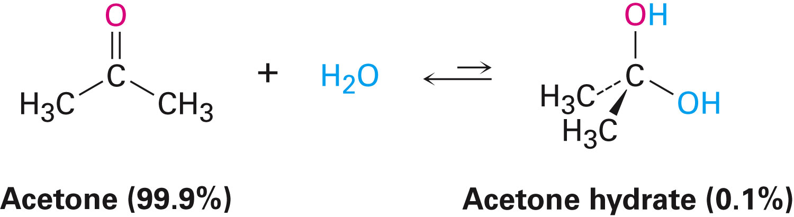
Nucleophilic Addition of H₂O: Hydration
Aldehydes and ketones react with water to yield 1,1-diols or geminal diols
Hydration is reversible
Gem diol can eliminate water
Position of the equilibrium depends on structure of carbonyl compound
Notes:
Nucleophilic addition of H₂O: Hydration

Slide 31
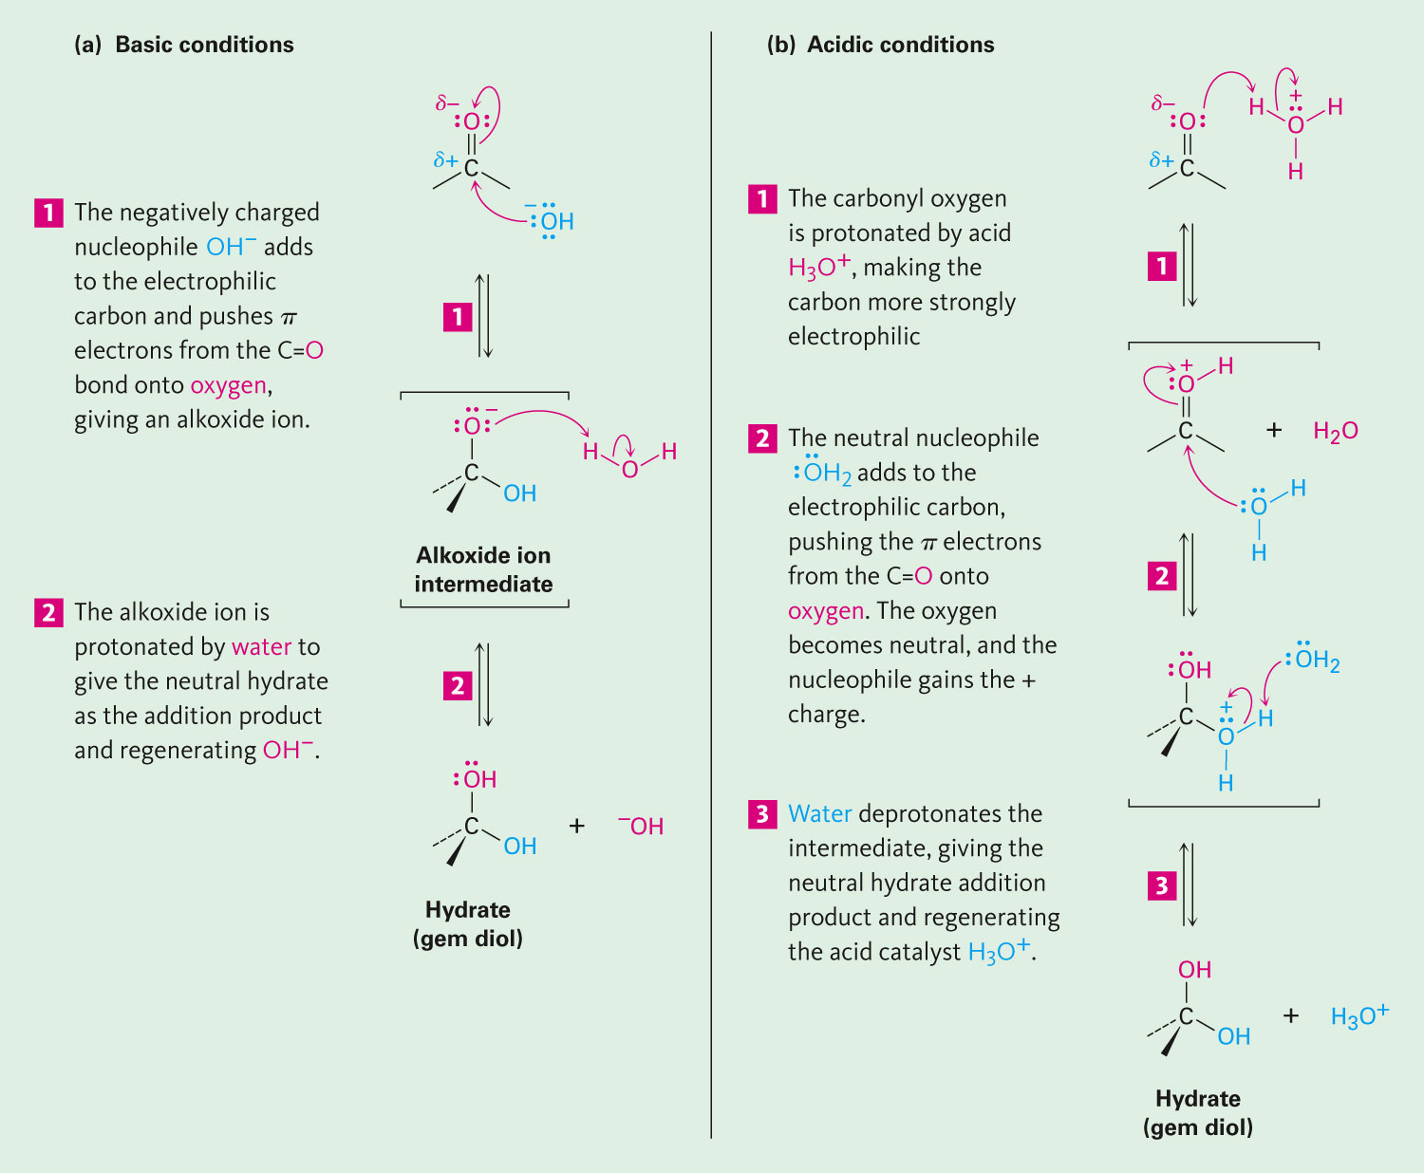
Base-Catalyzed Addition of Water
Addition of water is catalyzed by both acid and base
Water is converted into hydroxide ion
Better nucleophile
Notes:
Nucleophilic addition of H₂O: Hydration

Slide 32
Acid-Catalyzed Addition of Water
Protonation converts carbonyl compound into an electrophile
Notes:
Nucleophilic addition of H₂O: Hydration

Slide 33
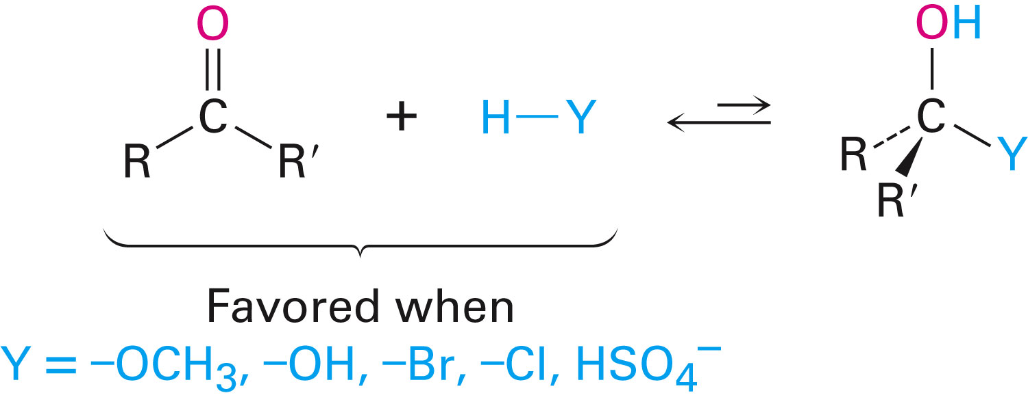
Addition of H–Y to C=O
Y is electronegative, gives an addition product
Can stabilize a negative charge
Formation is readily reversible
Notes:
Nucleophilic addition of H₂O: Hydration

Slide 34
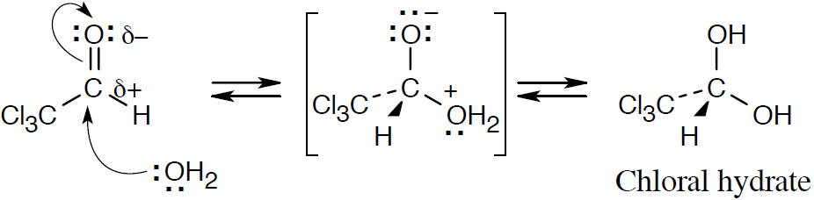
Worked Example
When dissolved in water, trichloroacetaldehyde exists primarily as its hydrate, called chloral hydrate
Show the structure of chloral hydrate
Solution:
Notes:
Nucleophilic addition of H₂O: Hydration

Slide 35
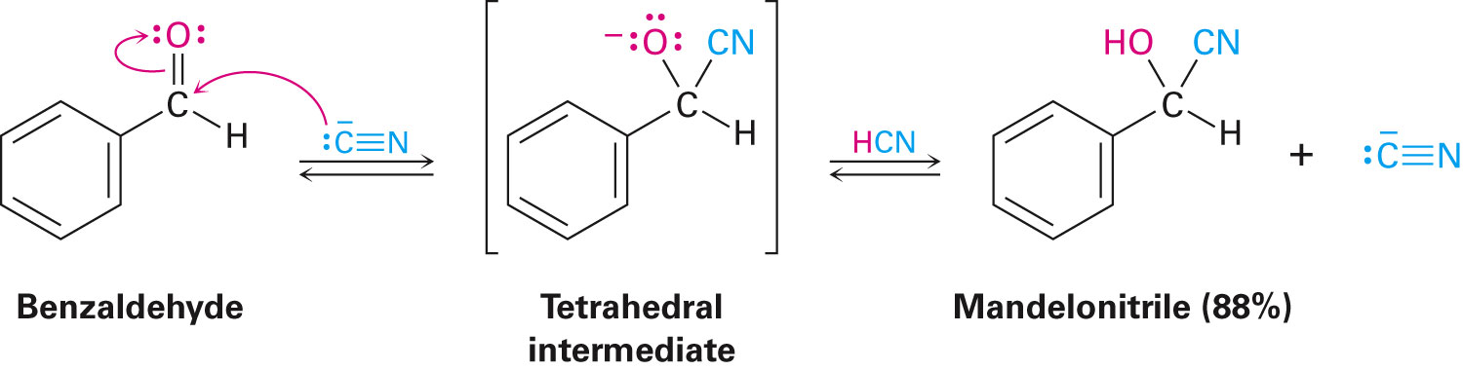
Nucleophilic Addition of HCN: Cyanohydrin Formation
Cyanohydrins: Product of nucleophilic reaction between aldehydes and unhindered ketones with HCN
Addition of HCN is reversible and base-catalyzed, generating nucleophilic cyanide ion, CN⁻
Addition of CN⁻ to C=O yields a tetrahedral intermediate, which is then protonated
Equilibrium favors cyanohydrin adduct
Notes:
Nucleophilic addition of HCN: Cyanohydrin formation

Slide 36
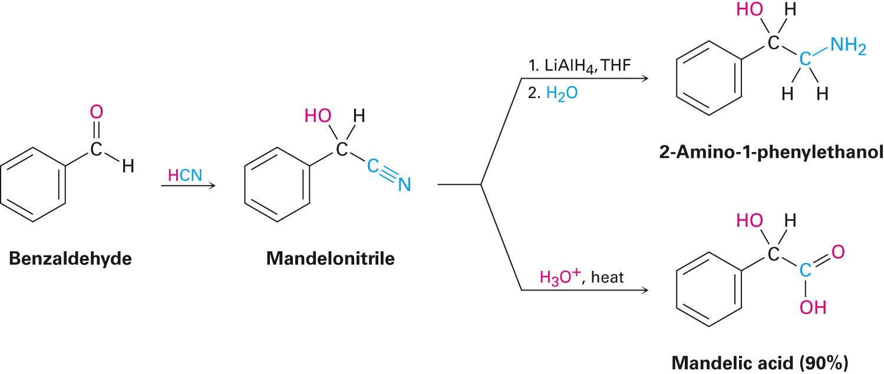
Uses of Cyanohydrins
The nitrile group (R–C≡N) can be reduced with LiAlH₄ to yield a primary amine (RCH₂NH₂)
Can be hydrolyzed by hot acid to yield a carboxylic acid
Notes:
Nucleophilic addition of HCN: Cyanohydrin formation

Slide 37
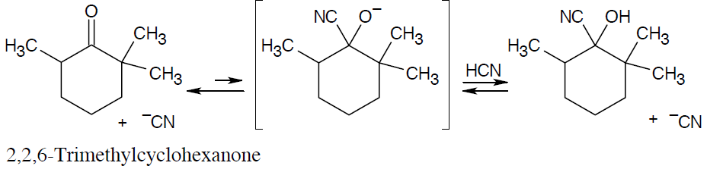
Worked Example
Cyclohexanone forms a cyanohydrin in good yield but 2,2,6-trimethylcyclohexanone does not Explain
Solution:
Cyanohydrin formation is an equilibrium process
Addition of –CN to 2,2,6-trimethylcyclohexanone is sterically hindered by 3 methyl groups, equilibrium lies toward the side of unreacted ketone
Notes:
Nucleophilic addition of HCN: Cyanohydrin formation

Slide 38
Nucleophilic Addition of Grignard Reagents and Hydride Reagents: Alcohol Formation
Addition of hydride reagents: Reduction
Alcohols can be prepared by reduction of carbonyl compounds
Aldehydes reduced using NaBH₄ yields primary alcohols
Ketones are reduced in using similar methods to give 2° alcohols
Carbonyl reduction occurs by typical nucleophilic addition mechanism under basic conditions
Notes:
Nucleophilic addition of hydride and grignard reagents: Alcohol formation

Slide 39
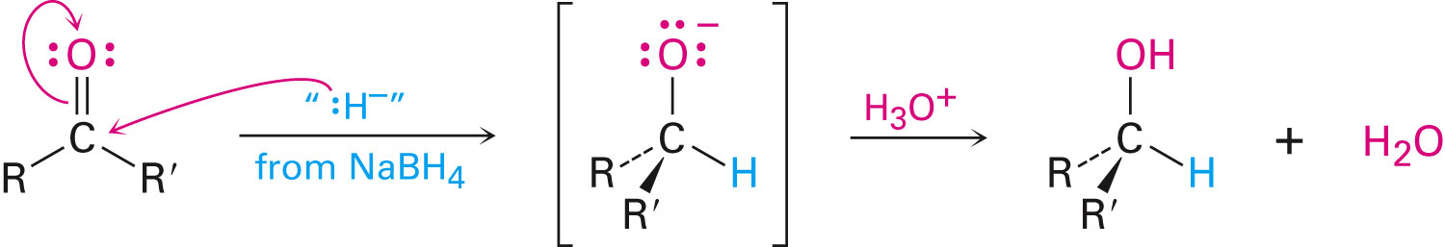
Nucleophilic Addition of Grignard Reagents and Hydride Reagents: Alcohol Formation
LiAlH₄ and NaBH₄ react as donors of hydride ion
Protonation after addition yields the alcohol
Reaction is effectively irreversible
Notes:
Nucleophilic addition of hydride and grignard reagents: Alcohol formation

Slide 40
Nucleophilic Addition of Grignard Reagents and Hydride Reagents: Alcohol Formation
Treatment of aldehydes or ketones with Grignard reagents yields an alcohol
Nucleophilic addition of R:– produces a tetrahedral magnesium alkoxide intermediate
A carbon-magnesium bond is strongly polarized, so a Grignard reagent reacts for all practical purposes
Notes:
Nucleophilic addition of hydride and grignard reagents: Alcohol formation

Slide 41
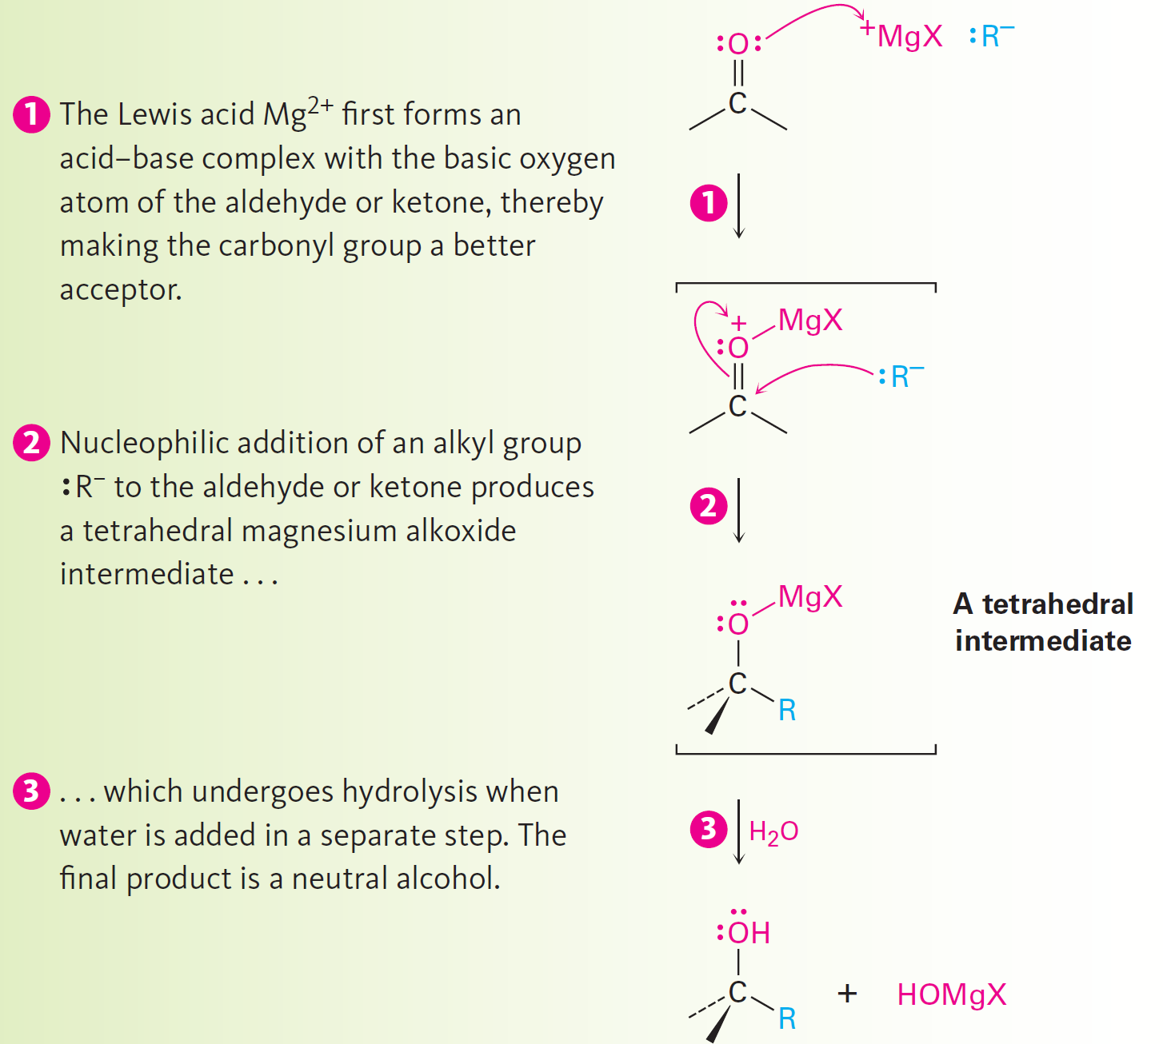
Figure 19.5 - Mechanism
Notes:
Nucleophilic addition of hydride and grignard reagents: Alcohol formation

Slide 42
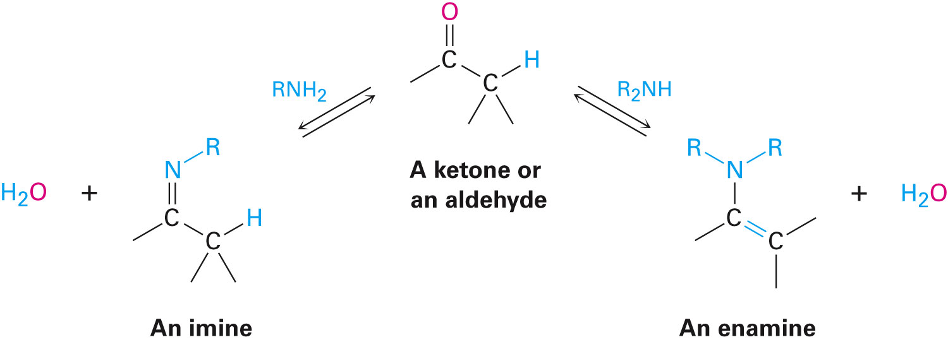
Nucleophilic Addition of Amines: Imine and Enamine Formation
RNH₂ adds to aldehydes and keytones to form imines, R₂C=NR
R₂NH adds similarly to yield enamines,
R₂N–CR=CR₂
Imines are common as intermediates in biological pathways, and are called Schiff bases
Notes:
Nucleophilic addition of amines: Imine and enamine formation

Slide 43
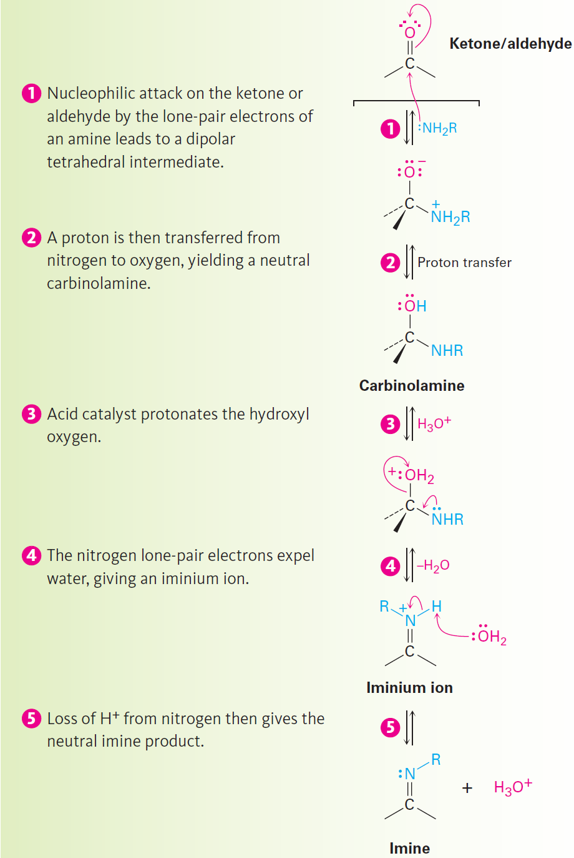
Figure 19.6 - Mechanism
Notes:
Nucleophilic addition of amines: Imine and enamine formation

Slide 44
Figure 19.6 - Mechanism
Notes:
Nucleophilic addition of amines: Imine and enamine formation

Slide 45
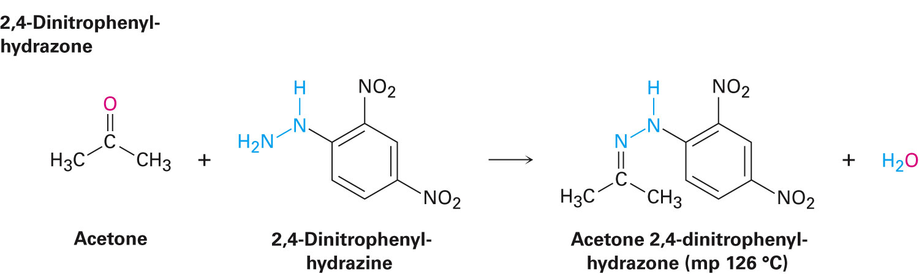
Imine Derivatives
Hydroxylamine forms oximes and 2,4-dinitrophenylhydrazine readily forms oximes and 2,4-dinitrophenylhydrazones
Occasionally prepared as a means of purifying and characterizing liquid ketones or aldehyde
Notes:
Nucleophilic addition of amines: Imine and enamine formation

Slide 46
Enamine Formation
Identical to imine formation up to the iminium ion stage
After addition of R₂NH and loss of water, proton is lost from adjacent carbon
Yields an enamine
Notes:
Nucleophilic addition of amines: Imine and enamine formation

Slide 47
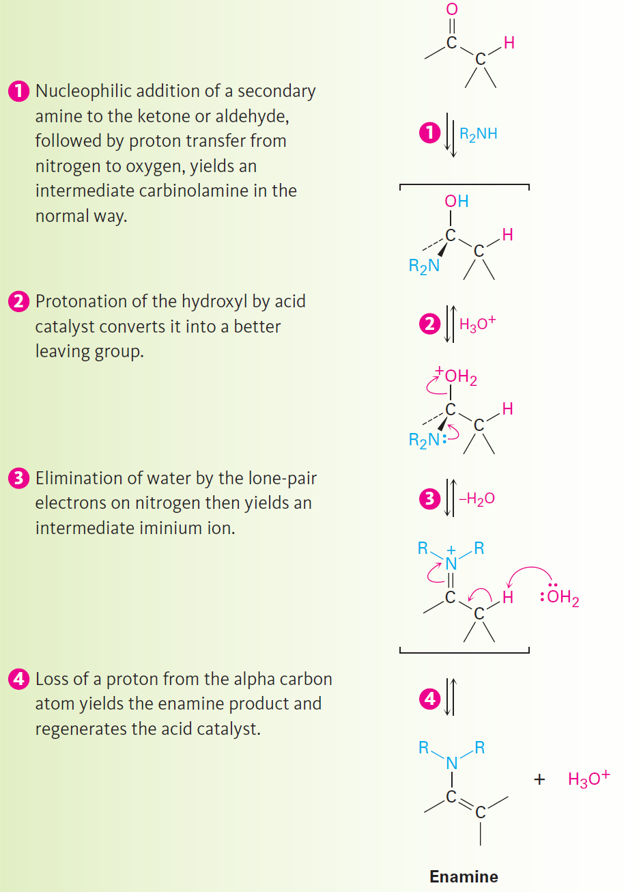
Figure 19.7 - Enamine Formation
Notes:
Nucleophilic addition of amines: Imine and enamine formation

Slide 48
Figure 19.7 - Enamine Formation
Notes:
Nucleophilic addition of amines: Imine and enamine formation

Slide 49
pH Dependence of Imine Formation
An acid catalyst is required in step 3 to protonate the intermediate carbinolamine
If enough acid is not present, the reaction is slow
If too much acid is present, the basic amine nucleophile is completely protonated
Nucleophilic addition reaction have unique requirements
Reaction conditions must be optimized to obtain maximum reaction rates
Notes:
Nucleophilic addition of amines: Imine and enamine formation

Slide 50
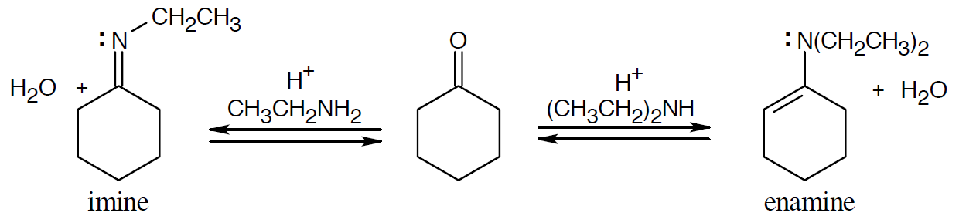
Worked Example
Show the products you would obtain by acid-catalyzed reaction of cyclohexanone with ethylamine, CH₃CH₂NH₂ and with diethylamine, (CH₃CH₂)₂NH
Solution:
Notes:
Nucleophilic addition of amines: Imine and enamine formation

Slide 51
Nucleophilic Addition of Hydrazine: The Wolff-Kishner Reaction
Treatment of an aldehyde or ketone with hydrazine, H₂NNH₂, and KOH to convert the compound to an alkane
Involves formation of a hydrazone intermediate, R₂C=NNH₂, followed by:
Base-catalyzed double-bond migration
Loss of N₂ gas to give a carbanion
Protonation to give the alkane product
More useful than catalytic hydrogenation
Notes:
Nucleophilic addition of hydrazine: The Wolff-Kishner Reaction

Slide 52
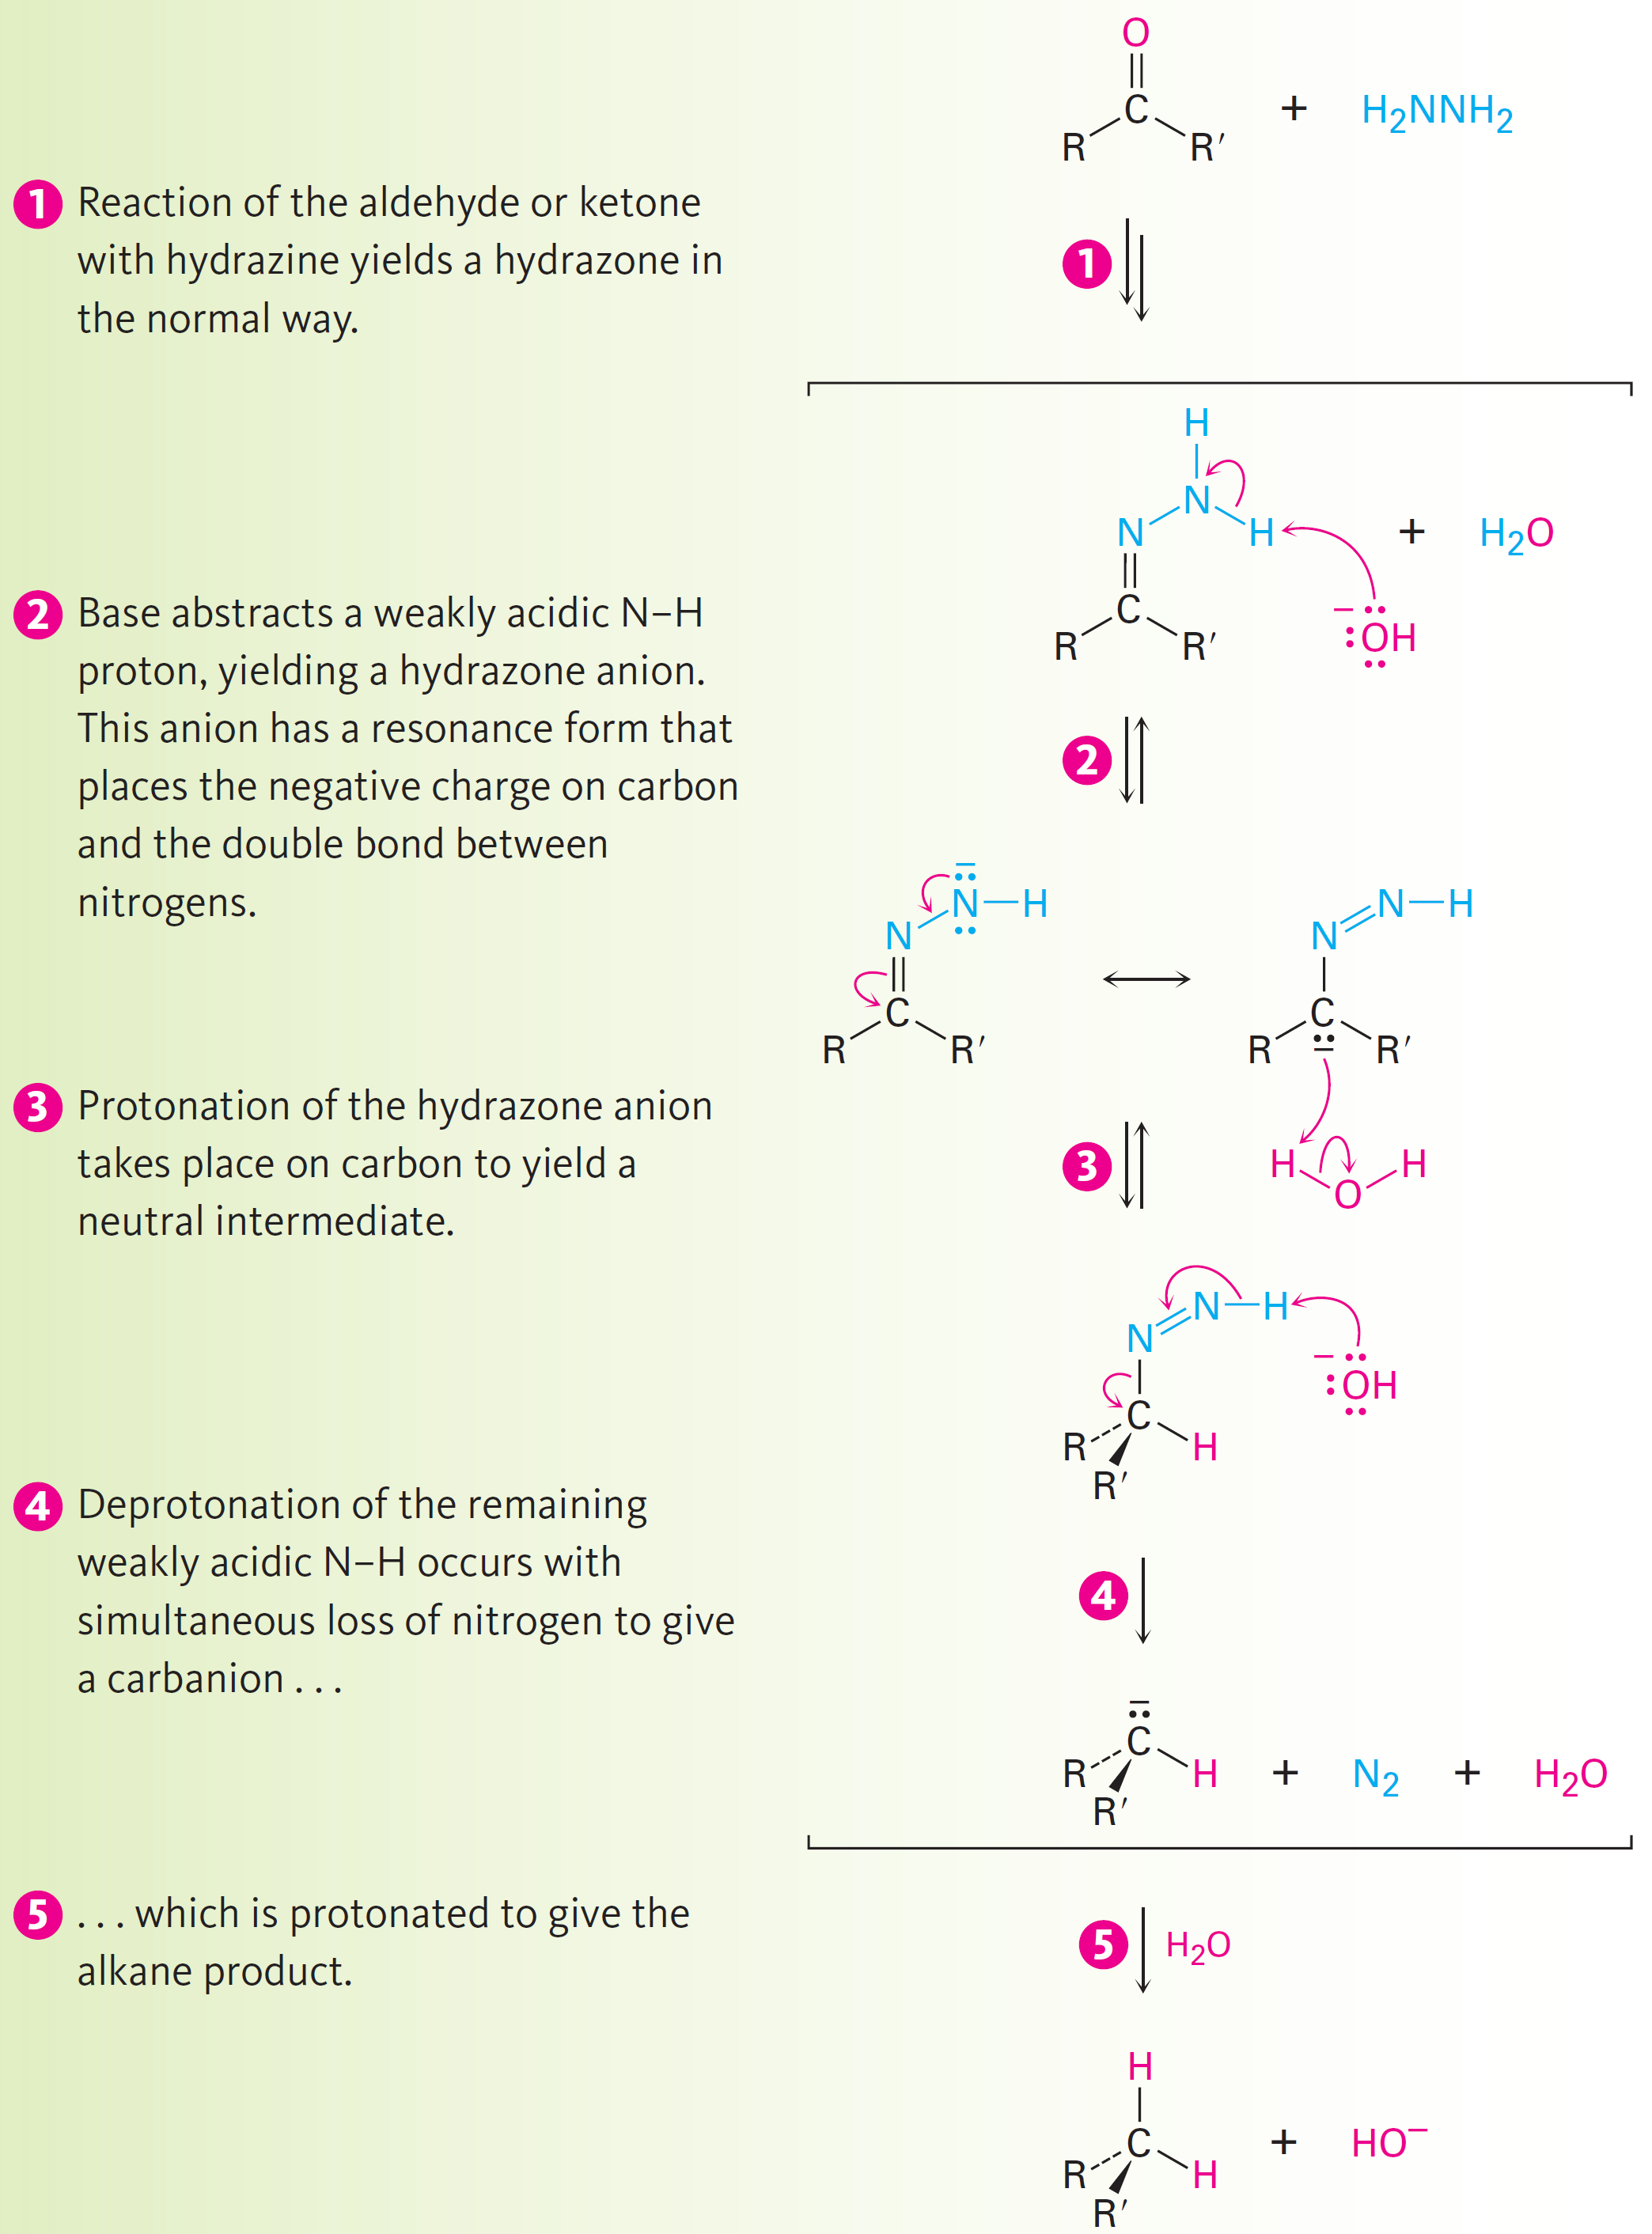
Figure 19.9 - Mechanism
Notes:
Nucleophilic addition of hydrazine: The Wolff-Kishner Reaction

Slide 53
Figure 19.9 - Mechanism
Notes:
Nucleophilic addition of hydrazine: The Wolff-Kishner Reaction

Slide 54
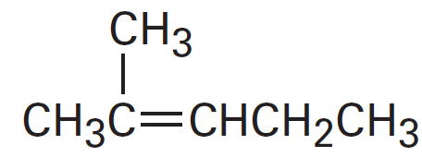
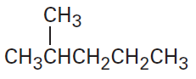
Worked Example
Show how you could prepare the following compounds from 4-methyl-3-penten-2-one, (CH₃)₂C=CHCOCH₃
a)
b)
Notes:
Nucleophilic addition of hydrazine: The Wolff– Kishner Reaction

Slide 55
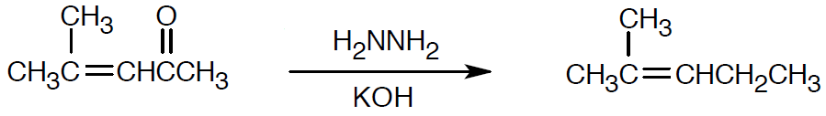
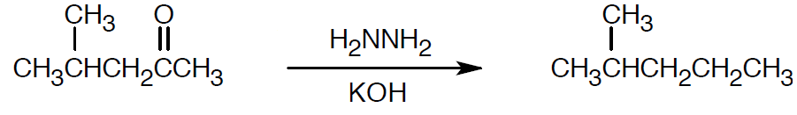
Worked Example
Solution:
a)
b)
Notes:
Nucleophilic addition of hydrazine: The Wolff– Kishner Reaction

Slide 56
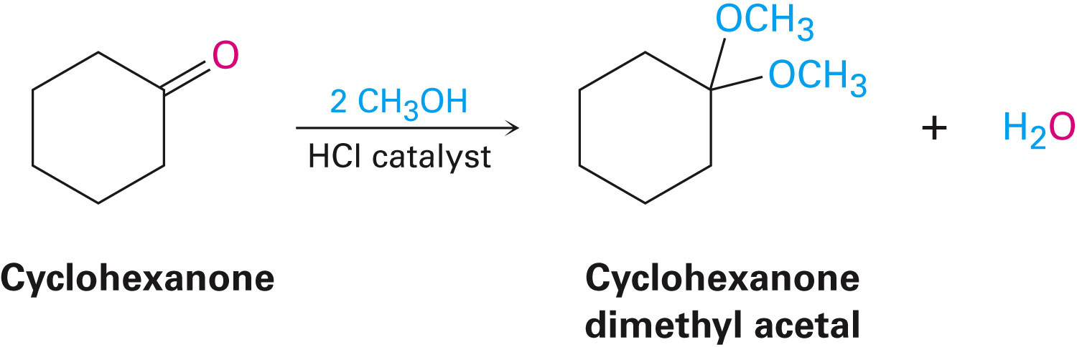
Nucleophilic Addition of Alcohols: Acetal Formation
Aldehydes and ketones react reversibly with 2 equivalents of an alcohol in the presence of an acid catalyst to yield acetals, R₂C(OR’)₂
Called ketals if derived from a ketone
Under acidic conditions reactivity of the carbonyl group is increased by protonation, so addition of an alcohol occurs rapidly
Notes:
Nucleophilic addition of alcohols: Acetal formation

Slide 57
Nucleophilic Addition of Alcohols: Acetal Formation
Nucleophilic addition of an alcohol to the carbonyl group initially yields a hydroxy ether called a hemiacetal
Formed reversibly
Reaction can be driven either forward or backward depending on the conditions
Notes:
Nucleophilic addition of alcohols: Acetal formation

Slide 58
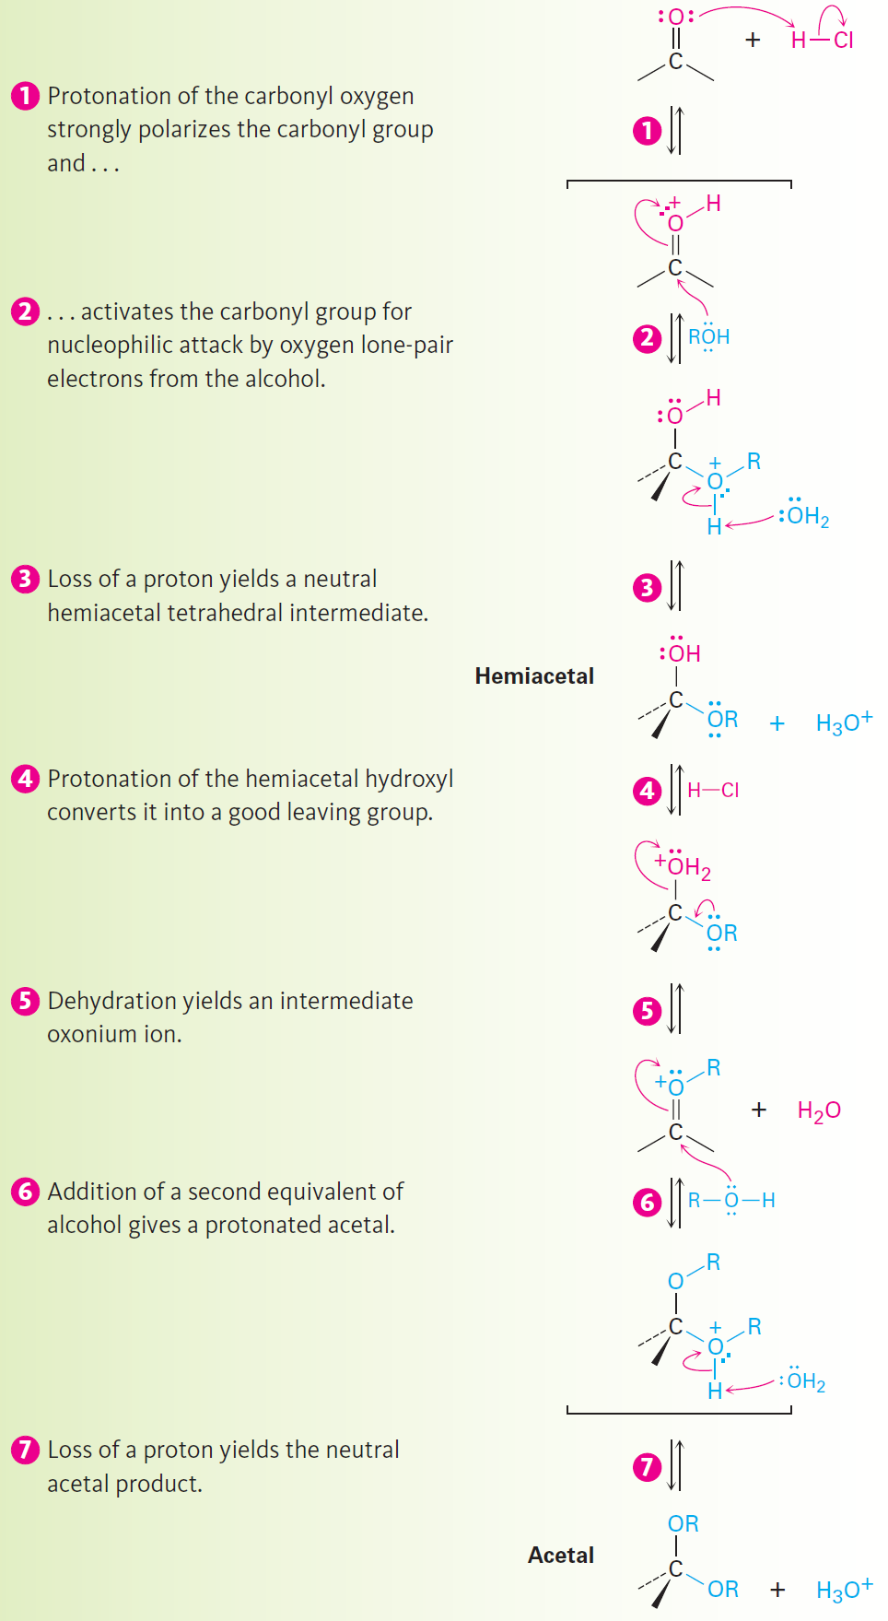
Figure 19.10 - Mechanism
Notes:
Nucleophilic addition of alcohols: Acetal formation

Slide 59
Figure 19.10 - Mechanism
Notes:
Nucleophilic addition of alcohols: Acetal formation

Slide 60
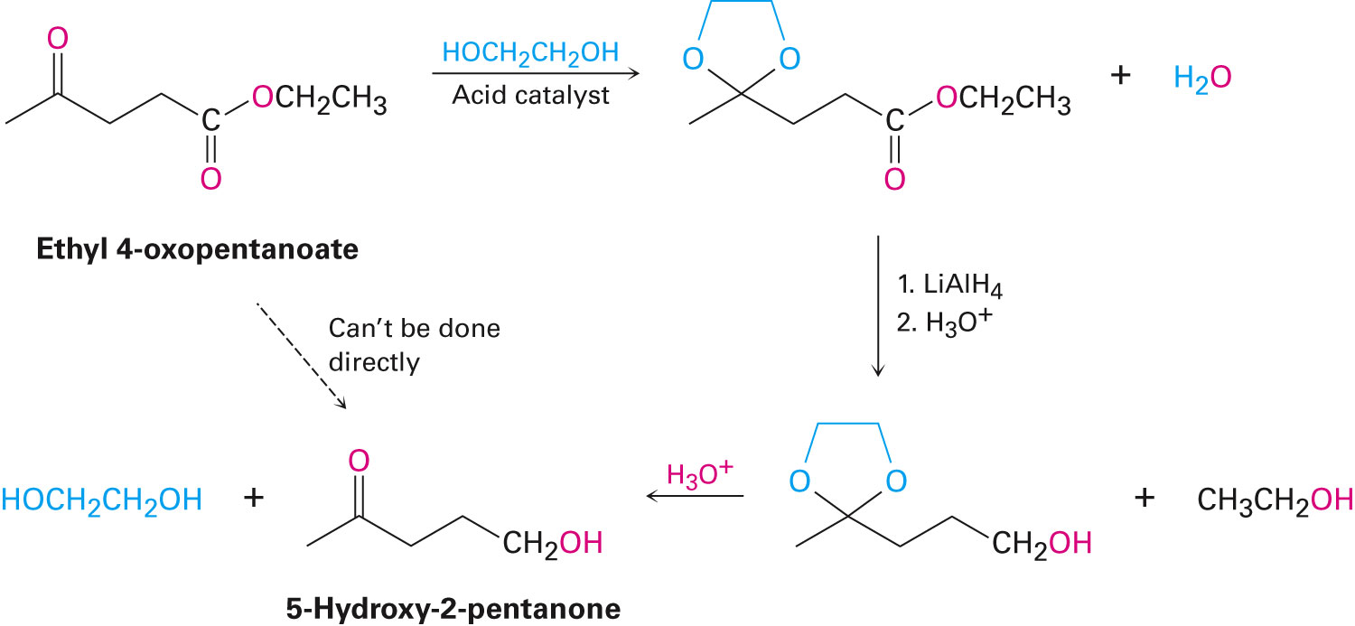
Uses of Acetals
Acetals can serve as protecting groups for aldehydes and ketones
Easier to use a diol to form a cyclic acetal
Notes:
Nucleophilic addition of alcohols: Acetal formation

Slide 61

Worked Example
Show the structure of the acetal obtained by acid-catalyzed reaction of 2-pentanone with 1,3-propanediol
Solution:
Notes:
Nucleophilic addition of alcohols: Acetal formation

Slide 62
Nucleophilic Addition of Phosphorus Ylides: The Wittig Reaction
Conversion of aldehydes and ketones into alkenes by means nucleophilic addition
Triphenylphosphorus ylide adds to an aldehyde or ketone to yield a four-membered cyclic intermediate called an oxaphosphetane
The intermediate spontaneously decomposes to give an alkene plus triphenylphosphine oxide
Notes:
Nucleophilic addition of phosphorus ylides: The Wittig Reaction

Slide 63

Nucleophilic Addition of Phosphorus Ylides: The Wittig Reaction
Triphenylphosphine is a good nucleophile in S_{N}2 reactions
Yields alkyltriphenylphosphonium salts
Cannot be used to prepare tetrasubstituted alkenes due to steric hindrance
Notes:
Nucleophilic addition of phosphorus ylides: The Wittig Reaction

Slide 64

Mechanism of the Wittig Reaction
Notes:
Nucleophilic addition of phosphorus ylides: The Wittig Reaction

Slide 65

Nucleophilic Addition of Phosphorus Ylides: The Wittig Reaction
Addition of CH₃MgBr to cyclohexanone and dehydration with POCl₃, yields a mixture of two alkenes of ratio (9:1)
Notes:
Nucleophilic addition of phosphorus ylides: The Wittig Reaction

Slide 66


Worked Example
What carbonyl compound and what phosphorus ylide might be used to prepare the following compounds
a)
b)
Notes:
Nucleophilic addition of phosphorus ylides: The Wittig Reaction

Slide 67


Worked Example
Solution:
a)
b)
Notes:
Nucleophilic addition of phosphorus ylides: The Wittig Reaction

Slide 68

Biological Reductions
Cannizzaro reaction: Nucleophilic addition of OH⁻ to an aldehyde to give a tetrahedral intermediate, which expels hydride ion as a leaving group and is thereby oxidized
A second aldehyde molecule accepts the hydride ion in another nucleophilic addition step and is thereby reduced
Notes:
Biological reductions

Slide 69

Figure 19.12 - Mechanism of Biological Aldehyde and Ketone Reductions
Notes:
Biological reductions

Slide 70

Worked Example
When o-phthalaldehyde is treated with base, o-(hydroxymethyl)benzoic acid is formed
Show the mechanism of this reaction
Notes:
Biological reductions

Slide 71

Worked Example
Solution:
Step 1 - Addition of –OH
Step 2 - Expulsion, addition of –H
Step 3 - Proton transfer
Step 4 - Protonation
Notes:
Biological reductions

Slide 72

Conjugate Nucleophilic Addition to α,β-Unsaturated Aldehydes and Ketones
1,2-addition: Addition of a nucleophile directly to the carbonyl group
Conjugate addition (1,4-addition): Addition of a nucleophile to the C=C double bond of an α,β-unsaturated aldehyde or ketone
Notes:
Biological reductions

Slide 73

Conjugate Nucleophilic Addition to α,β-Unsaturated Aldehydes and Ketones
Conjugate addition of amines
Primary and secondary amines add to α, β -unsaturated aldehydes and ketones to yield β-amino aldehydes and ketones
Notes:
Conjugate nucleophilic addition to α,β-unsaturated aldehydes and ketones

Slide 74

Conjugate Nucleophilic Addition to α,β-Unsaturated Aldehydes and Ketones
Conjugate addition of water
Yields β-hydroxy aldehydes and ketones, by adding reversibly to α,β-unsaturated aldehydes and ketones
Position of the equilibrium generally favors unsaturated reactant
Notes:
Conjugate nucleophilic addition to α,β-unsaturated aldehydes and ketones

Slide 75
Worked Example
Assign R or S stereochemistry to the two chirality centers in isocitrate,
Do OH and H add to the Si face or the Re face of the double bond?
Solution:
The –OH group adds to the Re face at carbon 2
–H⁺ adds to the Re face at carbon 3
Notes:
Conjugate nucleophilic addition to α,β-unsaturated aldehydes and ketones

Slide 76

Worked Example
Notes:
Conjugate nucleophilic addition to α,β-unsaturated aldehydes and ketones

Slide 77

Conjugate Nucleophilic Addition to α,β-Unsaturated Aldehydes and Ketones
Organocopper Reactions
Reaction of an α,β-unsaturated ketone with a lithium diorganocopper reagent
Diorganocopper reagents form by reaction of 1 equivalent of cuprous iodide and 2 equivalents of organolithium
1°, 2°, 3° alkyl, aryl, and alkenyl groups react
Alkynyl groups react poorly
Notes:
Conjugate nucleophilic addition to α,β-unsaturated aldehydes and ketones

Slide 78

Conjugate Nucleophilic Addition to α,β-Unsaturated Aldehydes and Ketones
Conjugate nucleophilic addition of a diorganocopper anion, R₂Cu–, to a ketone
Transfer of an R group and elimination of a neutral organocopper species, RCu, gives the final product
Notes:
Conjugate nucleophilic addition to α,β-unsaturated aldehydes and ketones

Slide 79


Worked Example
How might conjugate addition reactions of lithium diorganocopper reagents be used to synthesize
Solution:
Notes:
Conjugate nucleophilic addition to α,β-unsaturated aldehydes and ketones

Slide 80
Spectroscopy of Aldehydes and Ketones
Infrared Spectroscopy
Aldehydes and ketones show a strong C=O peak from 1660 to 1770 cm⁻¹
Aldehydes show two characteristic C–H absorptions in the 2720 to 2820 cm⁻¹ range
The bond’s force constant is lowered as a result of delocalization of vinyl/aryl groups
Lowers vibrational frequency
Angle strain in the carbonyl group raises the absorption position
Notes:
Spectroscopy of aldehydes and ketones

Slide 81

Figure 19.14 - Infrared spectra of (a) benzaldehyde and (b) cyclohexanone
Notes:
Spectroscopy of aldehydes and ketones

Slide 82

Table 19.2 - Infrared Absorptions of Some Aldehydes and Ketones
Notes:
Spectroscopy of aldehydes and ketones

Slide 83
Worked Example
Where would you expect each of the following compounds to absorb in the IR spectrum
a) 4-Penten-2-one
b) 3-Penten-2-one
Solution:
a) H₂C=CHCH₂COCH₃ absorbs at 1715 cm⁻¹
Not an α,ß-unsaturated ketone
b) CH₃CH=CHCOCH₃ absorbs at 1685 cm⁻¹
Is an α,ß-unsaturated ketone
Notes:
Spectroscopy of aldehydes and ketones

Slide 84

Spectroscopy of Aldehydes and Ketones
Nuclear magnetic resonance spectroscopy
Aldehyde proton signals absorb near 10 δ in ¹H NMR
Spin-spin coupling with protons on the neighboring carbon, J ≈ 3 Hz
Notes:
Spectroscopy of aldehydes and ketones

Slide 85

Spectroscopy of Aldehydes and Ketones
Carbonyl-group carbon atoms of aldehydes and ketones signal is at 190 δ to 215 δ
No other kinds of carbons absorb in this range
Saturated aldehyde or ketone carbons absorb in the region from 200 δ to 215 δ
Notes:
Spectroscopy of aldehydes and ketones

Slide 86

Spectroscopy of Aldehydes and Ketones
Mass spectrometry - McLafferty rearrangement
Aliphatic aldehydes and ketones that have hydrogens on their gamma (γ) carbon atoms rearrange as shown
Notes:
Spectroscopy of aldehydes and ketones

Slide 87

Mass Spectroscopy: α-Cleavage
Cleavage of the bond between the carbonyl group and the α carbon
Yields a neutral radical and an oxygen-containing cation
Notes:
Spectroscopy of aldehydes and ketones

Slide 88

Figure 19.16 - Mass Spectrum and the Related Reactions of 5-methyl-2-hexanone
Notes:
Spectroscopy of aldehydes and ketones

Slide 89

Worked Example
Describe the prominent IR absorptions and mass spectral peaks expected for the following compound:
Notes:
Spectroscopy of aldehydes and ketones

Slide 90

Worked Example
Solution:
The important IR absorption for the compound is seen at 1750 cm⁻¹
Products of alpha cleavage, which occurs in the ring, have the same mass as the molecular ion
Notes:
Spectroscopy of aldehydes and ketones

Slide 91

Worked Example
The McLafferty rearrangement appears at m/z = 84
Notes:
Spectroscopy of aldehydes and ketones

Slide 92
Summary
Most common general reaction type for aldehydes and ketones is nucleophilic addition reaction
Addition of HCN to aldehydes and ketones yields cyanohydrins
Primary amines add to carbonyl compounds yielding imines, or Schiff bases, and secondary amines yield enamines
Wolff-Kishner reaction is the reaction of an aldehyde or a ketone with hydrazine and base to give an alkane

Slide 93
Summary
Acetals, valuable protecting groups, are produced by adding alcohols to carbonyl groups
Phosphorus ylides add to aldehydes and ketones in the Wittig reaction to give alkenes
α,β-unsaturated aldehydes and ketones react with nucleophiles to give product of conjugate addition, or 1,4-addition

